Slide 1

OSYS2022
Port Scanner Script

Slide 2
Activity
In groups, work through the script and see if you can piece together how it works. Script we are covering in this class can be found here: https://github.com/sokdr/ScanPort/blob/master/ScanPort.sh
As a group, collect your thoughts on each of the following sections of the script and be prepared to share them back to the class:
Line 3
Line 4
Lines 6-9
Line 11 (view the readme here: https://github.com/sokdr/ScanPort)
Line 16
Lines 16-57

Slide 3

Line 3
Checks the ‘TERM’ environment variable for information on the type of terminal application being used
Determines how to clear the screen
Echo the clear-screen sequence for the current terminal

Slide 4

Line 4
The ‘trap’ command traps signals sent to your script
This example traps the ‘interrupt’ signal sent to bash when the user presses Ctrl+C on the keyboard
The ‘ctrl_c’ refers to a function that is called when an interrupt signal is trapped
Avoids interrupting a script when it may be modifying files or performing tasks that should not be interrupted

Slide 5
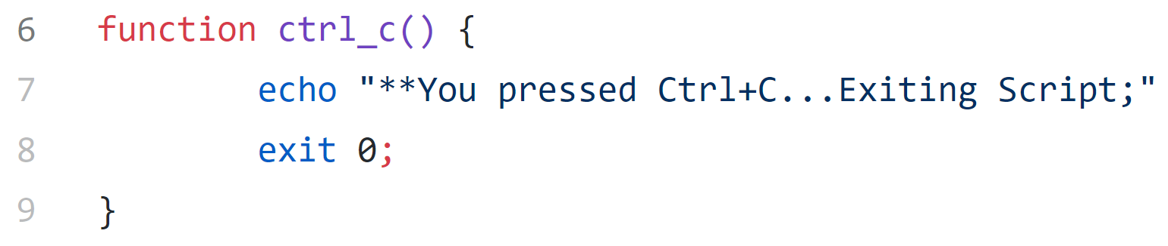
Lines 6-9
Function called ‘ctrl_c’
A function is a block of code that can be reused by calling the function name, either in the script where the function is defined or you can store them separately in individual files and call them in any number of scripts
This function echo’s a statement to the terminal then exits the script and sets the exit code to 0 (success)

Slide 6

Line 11
IP address that is entered by the user when executing the script is saved into a ‘positional parameter’ variable
Quotation marks are used around $1 so that if the variable includes a space then it is handled properly (always use double quotation marks around positional parameters)
Script is executed with: ./scanport.sh 192.168.208.10
$0 = ./scanport.sh
$1 = 192.168.208.10

Slide 7
Line 16
If statement comparing the IP address provided with the expected structure of an IP address
[[ ]] = bash shell keyword that performs a test using the expressions contained within the brackets
=~ is a matching operator that tests if the string to the left matches the expression to the right
[0-9]{1,3} = the test checks the string for characters between 0-9, has to find a minimum of 1 matching characters, and maximum of 3, before the first period
\. Is defining the periods in the IP address, but the \ is used as an escape character so bash reads the period literally instead of as a special character

Slide 8
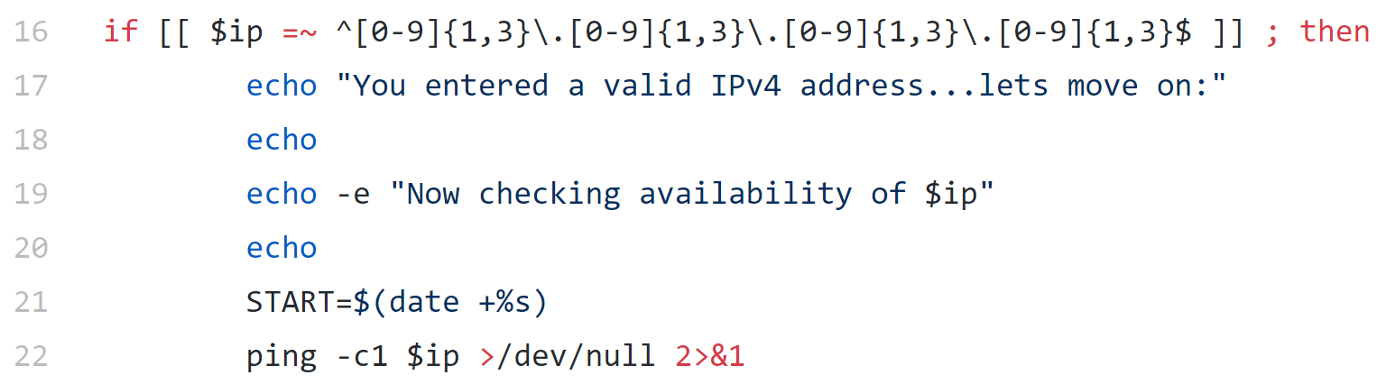
Lines 16-57
If the $ip variable matches the expression then it will echo back
Creates a variable named ‘START’ containing the date in format of seconds
Pings the IP address once, redirects output to null file
2>&1 is used to redirect standard error (2) to standard output (1) which is being redirected to /dev/null

Slide 9
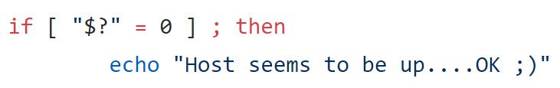
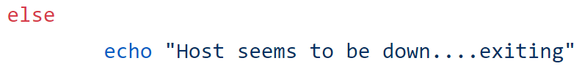
Lines 16-57
$? Checks the status code from the previous command that was executed (ping against $ip)
If the ping was successful then it performs an echo command
If the ping was not successful (status of something other than 0) then it goes to the ‘else’ statement and executes the echo command

Slide 10
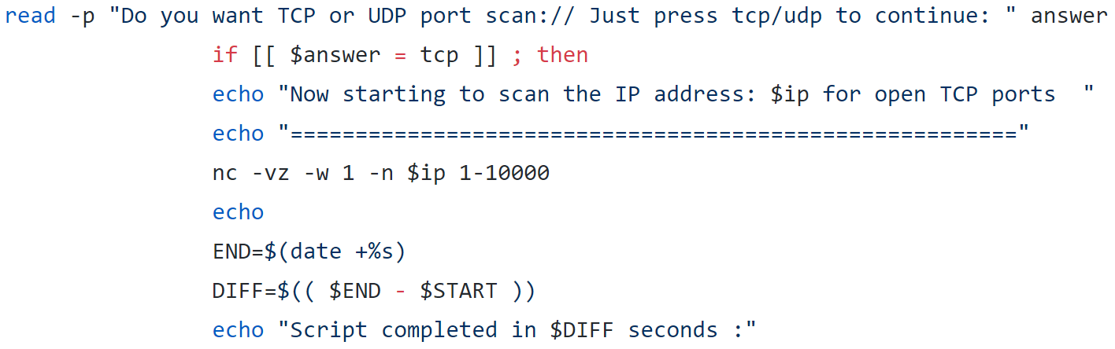
Lines 16-57
Read –p prompts the user to enter ‘TCP’ or ‘UDP’, saves input to variable called ‘answer’
If the answer variable contains ‘TCP’ then it performs the commands
If the answer variable does not contain ‘TCP’ then it moves on to the next ‘elif’ condition

Slide 11
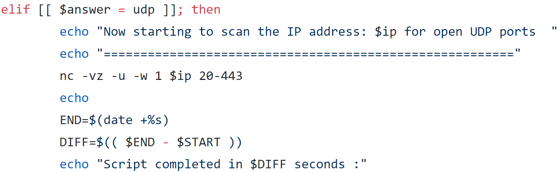
Lines 16-57
Same again but checks for ‘UDP’ instead of ‘TCP’
END variable is set to be date formatted into seconds
DIFF variable subtracts the time in $START from $END to leave the difference between the two, in seconds, which is then displayed in output on the screen

Slide 12
Lines 16-57
If $answer does not contain ‘TCP’ or ‘UDP’ then it is passed on to the ‘else’ condition which executes an echo command telling the user to run the script again

